Slide 1
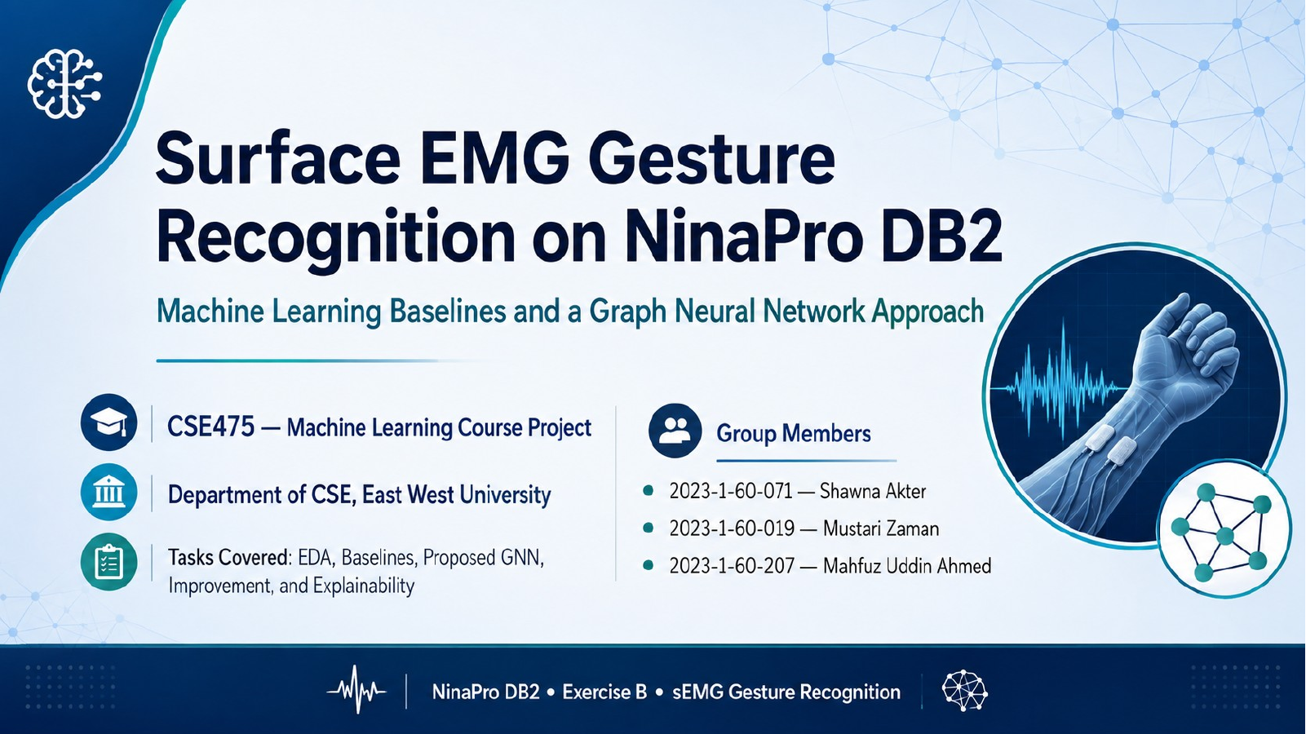

Slide 2
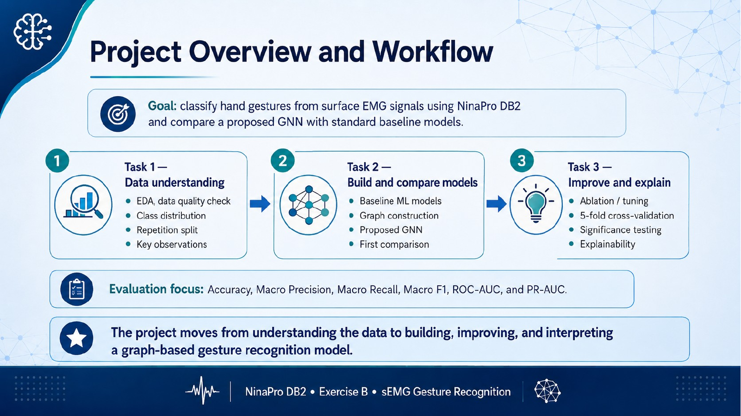

Slide 3
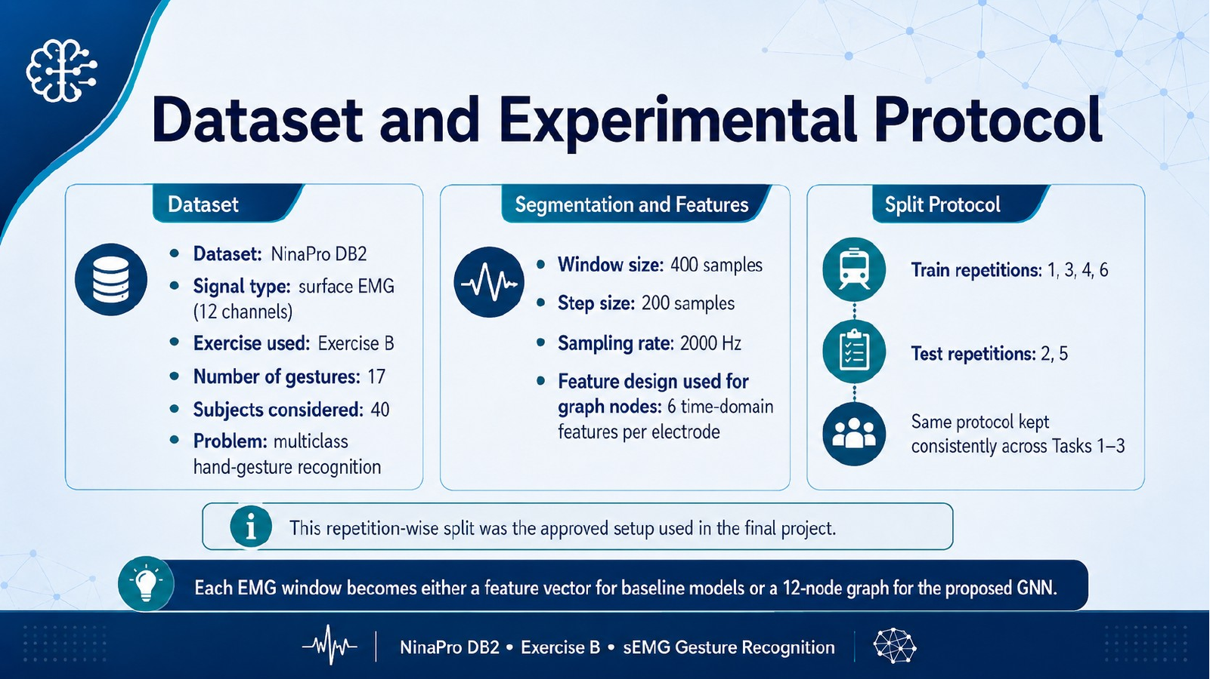
Dataset
Feature & Graph Setup
Approved Split Protocol
• NinaPro DB2 surface EMG dataset
• Exercise B / E1 used for the study
• 40 subjects, 12 EMG channels
• 17 active hand gestures
• Multiclass gesture-recognition task
• Window size: 400 samples; step: 200
• Baseline vector: 246 engineered features → selected 200
• GNN nodes: 12 electrodes
• Node features: 15 descriptors/electrode
• Edges: sample-specific top-k=5 electrode correlations
• Train repetitions: 1, 3, 4, 6
• Test repetitions: 2, 5
• Same protocol used across Tasks 1–3
• Task 3 dev split: 1,3,4 train and rep 6 validation
Each EMG window is represented as a feature vector for baselines or as a dynamic electrode graph for the GNN.

Slide 4
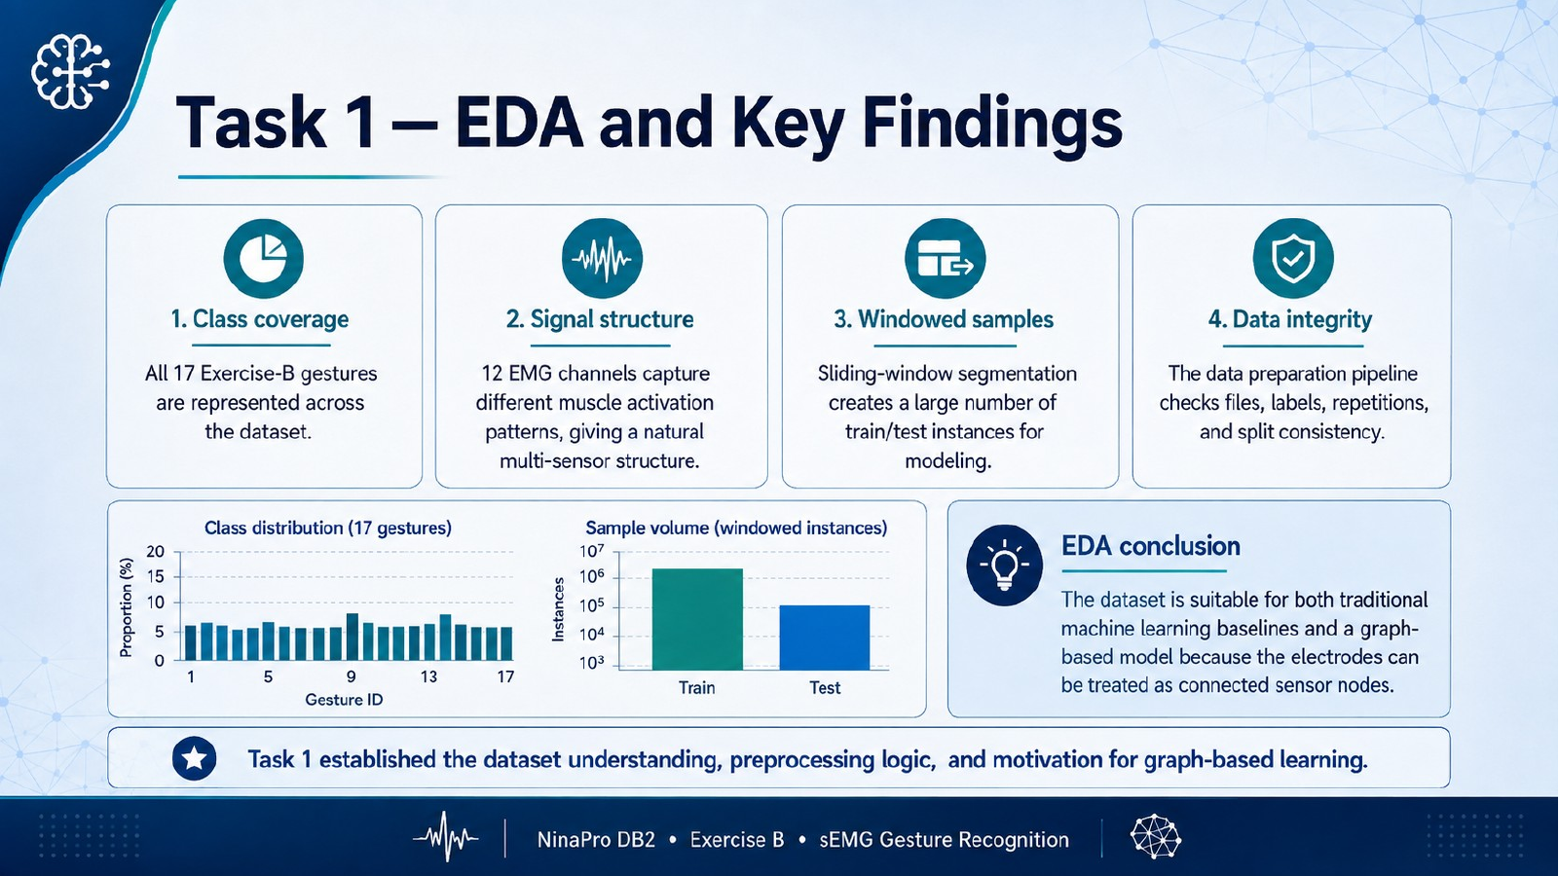
1. Class coverage
2. Balanced segments
3. Windowed samples
4. Data integrity
All 17 Exercise-B gestures are represented in the active-gesture subset.
Training segments were balanced: 2,720 active segments, 160 per gesture.
Sliding-window extraction produced 181,434 modeling windows.
Files, labels, repetitions, finite values, and split consistency were checked.
EDA Evidence
EDA conclusion
Finding
Value
Active gestures
17
NinaPro DB2 Exercise B provides a suitable multi-channel sEMG setting for both classical baselines and graph-based learning. Treating the 12 electrodes as connected nodes is a meaningful modeling choice.
Training segments
2,720
Segments / gesture
160
Total windows
181,434
Train / Test windows
121,173 / 60,261
Task 1 established the dataset understanding, preprocessing logic, and motivation for graph-based modeling.

Slide 5
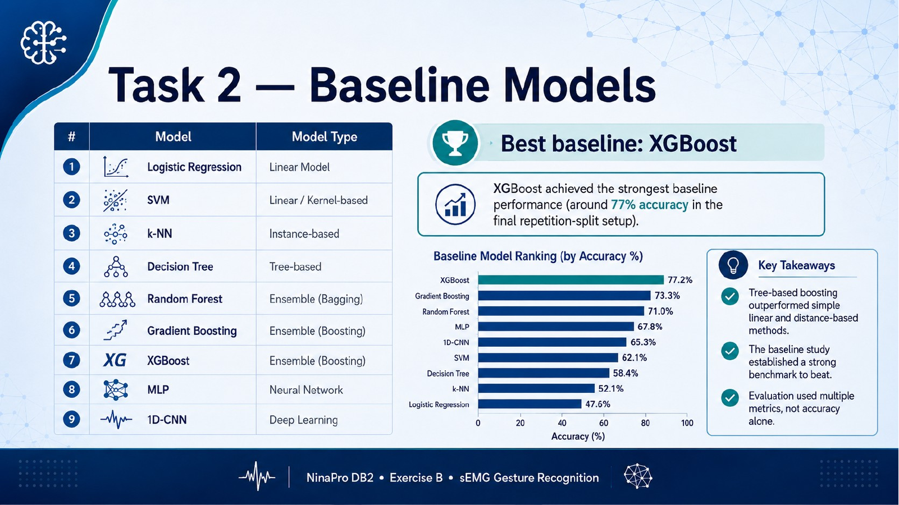
Seven baseline models evaluated
Best baseline: XGBoost
Model
Type
XGBoost achieved the highest baseline result under the approved repetition-wise split: 77.69% accuracy and 77.39% Macro-F1.
Logistic Regression
Linear
Linear SVM
Linear margin
Decision Tree
Tree
Baseline ranking by Accuracy
Random Forest
Bagging
XGBoost
77.69%
Random Forest
77.24%
Gradient Boosting
Boosting
Grad. Boosting
75.89%
XGBoost
Boosting
MLP
70.32%
MLP
Neural net
Decision Tree
46.77%
Linear SVM
35.15%
Log. Reg.
34.85%
Takeaway: boosting-based and ensemble models became the strongest benchmark for the GNN.

Slide 6
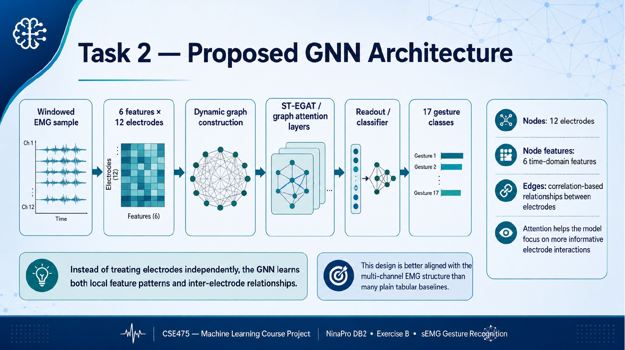
Raw sEMG
Temporal CNN
Node features
Dynamic graph
3 GAT blocks
Readout
Fusion
Output
12×400 window
→
shared raw-signal branch
→
12 electrodes × 15 descriptors
→
top-k=5 correlations
→
edge-aware attention
→
attention + mean + max
→
200-feature global MLP
→
17 gesture classes
Why graph? The 12 electrodes are not independent; correlation-based edges let the model learn inter-electrode muscle-activation relationships.
Architecture view: raw temporal signal, electrode-level descriptors, dynamic graph attention, and global engineered features are combined for classification.
The proposed ST-EGAT is aligned with the multi-channel structure of sEMG gesture data.

Slide 7
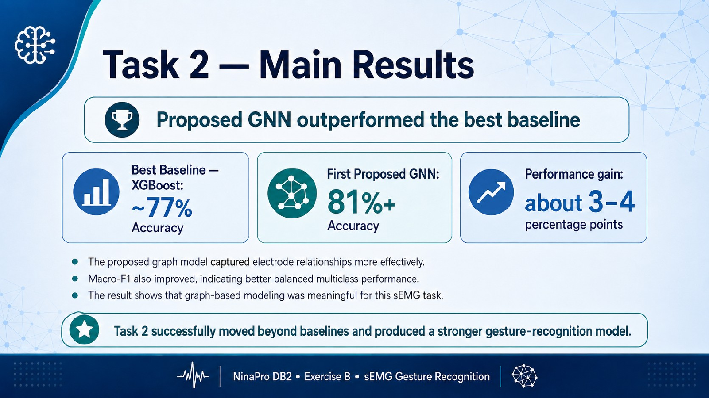
First proposed ST-EGAT outperformed the strongest classical baseline.
XGBoost
First ST-EGAT
Macro-F1 gain
77.69%
81.16%
+3.59 pp
Accuracy
Accuracy
vs. XGBoost
77.39% Macro-F1
80.98% Macro-F1
Accuracy gain: +3.47 pp
Model
Accuracy
Macro-F1
ROC-AUC
PR-AUC
XGBoost
77.69%
77.39%
98.25%
85.99%
First ST-EGAT
81.16%
80.98%
97.66%
86.93%
Macro-F1 improved with accuracy, indicating a balanced multiclass gain rather than only a headline accuracy change.

Slide 8
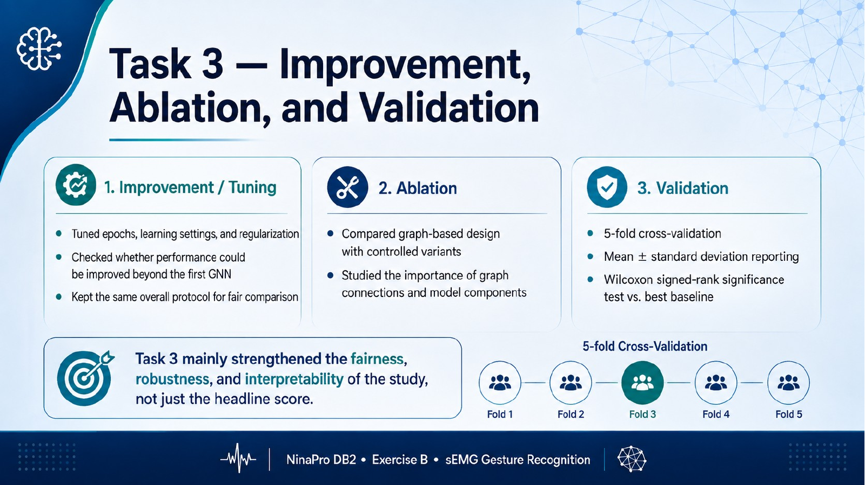
Selected variant
Final held-out test
5-fold evidence
Binary Edges ST-EGAT
Best epoch: 36
Validation Macro-F1: 69.17%
Graph gain vs No Graph: +1.52 pp
XGBoost: 77.69 / 77.39
Task 2 GNN: 81.16 / 80.98
Task 3 GNN: 80.37 / 80.20
(Accuracy / Macro-F1)
GNN Macro-F1: 67.13 ± 1.65%
XGBoost Macro-F1: 65.10 ± 2.11%
Wilcoxon p = 0.03125
Ablation snapshot: validation Macro-F1
Task 3 strengthened the fairness and robustness of the study through ablation, cross-validation, and significance testing. The final Binary-Edge model stayed close to the first GNN while still beating XGBoost.
Binary Edges
69.17%
No Graph
67.65%
First ST-EGAT
68.93%
Final ST-EGAT+
68.84%

Slide 9
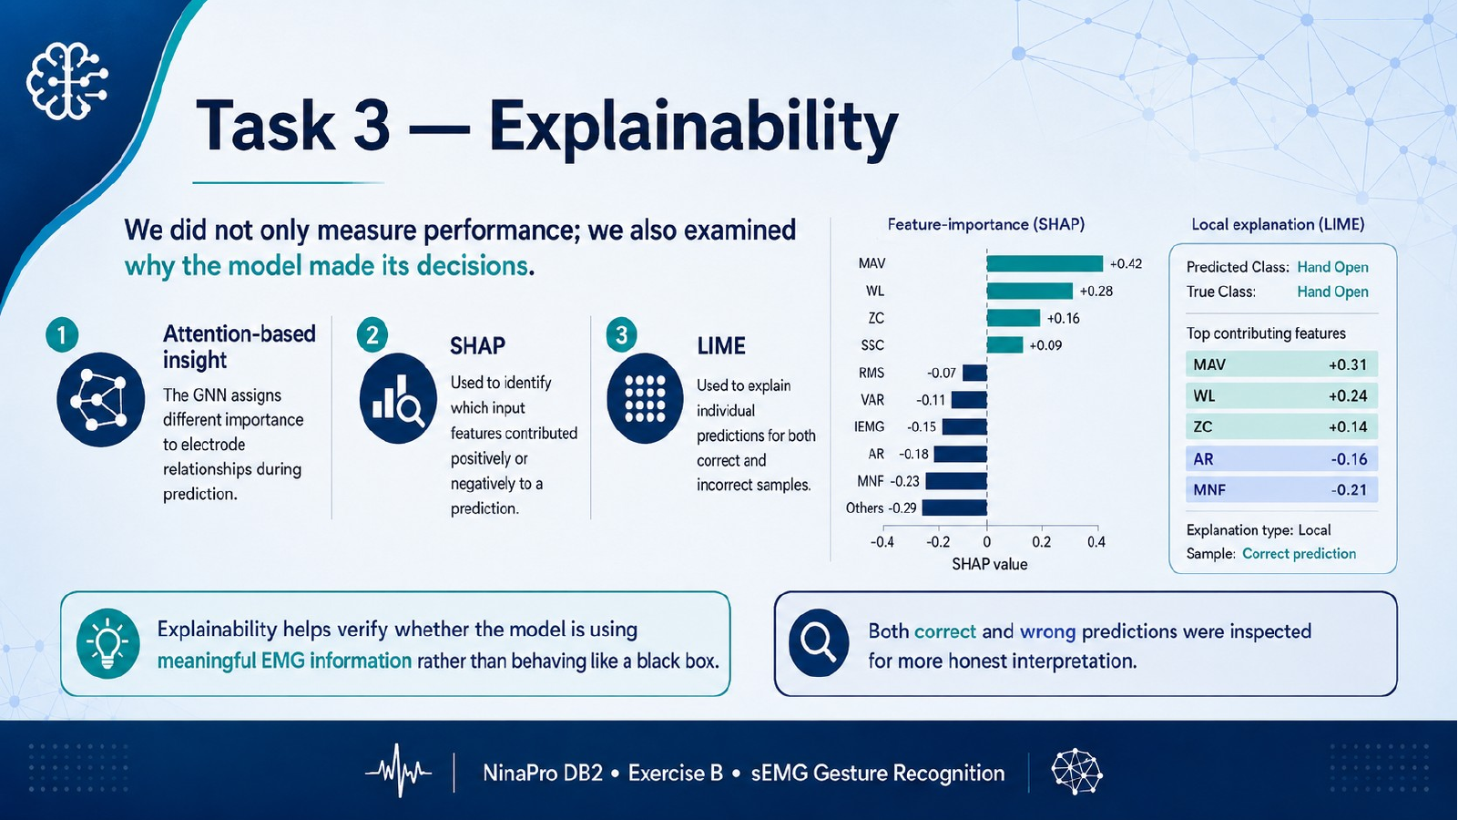
The final Binary-Edge ST-EGAT was explained using attention, SHAP, and LIME.
Attention
SHAP
LIME
Electrode attention indicates which channels receive stronger graph-readout importance during prediction.
Feature attribution was computed to identify influential engineered sEMG features.
Local explanations were generated for both correct and incorrect predictions.
Correct prediction example
Wrong prediction example
Subject S31, repetition 5
Actual G13 → Predicted G13
Confidence: 99.92%
Subject S26, repetition 5
Actual G13 → Predicted G14
Confidence: 99.69%
Top SHAP feature identified in the final explanation: ch11_WAMP.

Slide 10
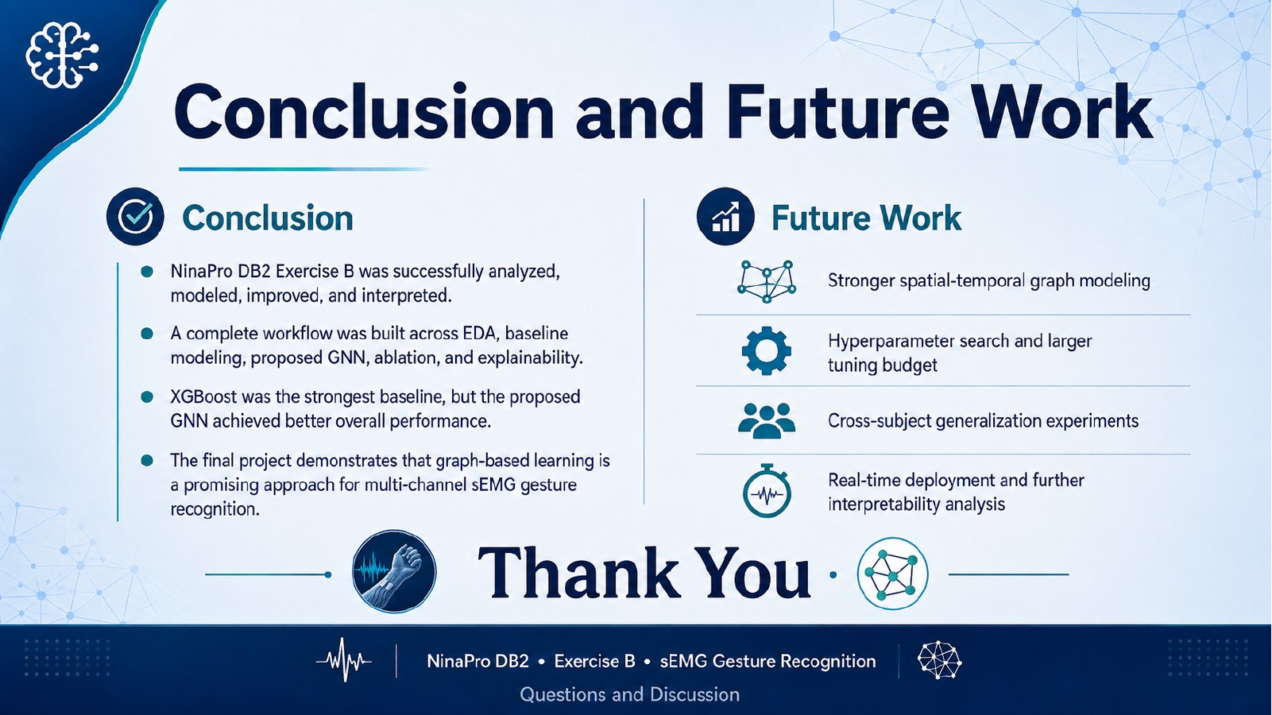
Conclusion
Future Work
• NinaPro DB2 Exercise B was analyzed through EDA, baselines, GNN modeling, ablation, and explainability.
• XGBoost was the strongest classical baseline: 77.69% accuracy / 77.39% Macro-F1.
• Task 2 First ST-EGAT achieved the highest held-out score: 81.16% / 80.98%.
• Task 3 Binary-Edge ST-EGAT achieved 80.37% / 80.20% and was validated with CV and XAI.
• Stronger spatial-temporal graph modeling
• Larger hyperparameter search and tuning budget
• Cross-subject generalization experiments
• Real-time deployment and deeper interpretability analysis
Thank You
Questions and Discussion

